Slide 1

Department of Information Technology
NBA Accredited A.P. Shah Institute of Technology G.B. Road, Kasarvadavli, Thane(W), Mumbai-400615 UNIVERSITY OF MUMBAI Academic Year 2022-2023

Slide 2
A Project Report on ML Based Comprehensive Web Framework Facilitating Paying Guests. Submitted in partial fulfillment of the degree of
Bachelor of Engineering(Sem-8) in INFORMATION TECHNOLOGY
By- Samiksha Pawar (19104020) Shreyasha Vinerkar (19104032) Ragini Pandey (19104032) Under the Guidance of Prof. Mandar Ganjapurkar

Slide 3
1.Project Conception and Initiation

Slide 4
1.1 Abstract
Internet has various rental and paying guests system for smooth transition of a student or a corporate fellow in a new city.
It is important to validate the documents and also go through various recommendations before accommodating a living area for an individual, considering the amount of time and cost invested by an individual to find a suitable locality. The project includes document validation of government document like PAN card through Convolutional Neural Network(CNN) model.
This project aims to recommend a suitable house to a user based on their preferences and requirements. The recommendation system uses the K-Nearest Neighbors (KNN) algorithm to find the houses that are most similar to the user’s preferences.
The project enables the user to geofence the area for better navigation while also carving out the desired area if required by using Google Geolocation API.

Slide 5
1.2 Objectives
To ensure the authorized and validated users are granted access to the rental portal by practicing Google Authentication and SVM model for document validation.
To aid the user in finding the intended location through navigation.
To make a user-friendly web framework that utilizes Geo-fencing.
To create a user-friendly method that allows the tenant to choose property of their choice.

Slide 6
1.3 Literature Review
S.No. | Paper Name | Description
1. | Guy, N.N.. A Recommender system for rental properties. Ph.D. thesis; Strathmore University; 2017 | A recommender system that enables users to carry out a preference-based search on rental properties and enables them to refine those preferences using example-critiquing in case they are not satisfied with initial search results. This recommendation approach has been shown to provide more accurate search results. The system was developed as a Web application using the Ruby on Rails framework. Furthermore, the system was tested to ascertain that it performed as designed.

Slide 7
1.3 Literature Review
2. | Alrawhani E.M., Basirona H, Sa’ayaa Z.Real estate recommender system using case-based reasoning approach Journal of Telecommunication, Electronic and Computer Engineering (JTEC), 8 (2) (2016) | A Real Estate Recommender System using Case-Based Reasoning Approach which can help customers to find a desired property. This proposed system uses a recommendation approach during search for property which assists the customers to find appropriate property and make decisions where they need the required knowledge to judge a particular property.Furthermore information available is very huge, so the recommender system assists the user to filter the available dataset according to user needs.

Slide 8
1.3 Literature Review
3. | Jinhao, X., Arefin, M.S., Zhiming, C., Morimoto, Y.. Real estate recommender: Location query for selecting spatial objects. In: 2012 Third International Conference on Networking and Computing. IEEE; 2012 | In the proposed method, a user specifies a list of favorable surrounding facilities within a specified distance in his preferred location. We evaluate each real estate based on how many favorable surrounding facilities are there within the specified distance.

Slide 9
1.4 Problem Definition
A student will face difficulty to find house for rent as they do not know the nearest house that available to their respective college.
Even if a students finds a house for rent , they may have location issues related as well.
Users may also fall into the trap of frauds and to prevent fraud, the users must be authorized and should complete certain criteria of requirements.
Many students are click-baited or mislead to unauthentic properties or false claims.

Slide 10
1.5 Scope
To discuss the scope of our project-
We have used content-based filtering with KNN to recommend properties to users based on the similarity of their features such as location, number of rooms, square footage, and amenities.
We collected data on properties, including their features such as location, number of rooms, square footage, amenities, and other relevant factors. The data is preprocessed and cleaned.
We use KNN to find the k nearest neighbors of each property based on their feature similarity. The similarity metric used can be cosine similarity or Euclidean distance, depending on the dataset.
Hence the renters seem to have difference of choices when it comes to selecting their home.

Slide 11
1.6 Technology stack
SOFTWARE REQUIREMENTS
Front-end: HTML, CSS, React JS, Flask
Back-end: Firebase, Node JS
Geo Fencing: Google API
Algorithms Used: SVM, CNN, KNN

Slide 12
1.7 Benefits for environment & Society
This web framework incorporates diverse cutting-edge technologies, including Machine Learning, during its development to enhance the functionality of the web application. Thereby, through the utilization of content-based filtering and diverse Machine Learning algorithms, a comprehensive web application is developed.
As a result, a holistic system for housing rentals and relocation services was constructed, consisting of multiple components, such as:
– Displaying all rental properties based on the tenant’s preference using content based filtering
– Locate resources using Geocoding Maps API
– Searching for homes through Filtering
– Geofencing the desired location to get precise understanding of surrounding and facilities.

Slide 13
2. Project Design

Slide 14
2.1 Proposed System
Feature 1 : Web framework which is user friendly for the renters and tenants to navigate the area smoothly.
Feature 2 : With the help of Geo-Fencing the tenants will get information about the surroundings.
Feature 3 : To authorise the renters and tenants by submitting and validating the documents required.
Feature 4: To create a dashboard for the tenants and renters to enter their preferences and filter out the houses.

Slide 15
2.2 Design(Flow Of Modules)
The flow of our system is-
The start of system process from the login and signup of the user towards their journey to find a house.
The user can register through E-mail or Username and password after validating the PAN card of a individual.
The renter can add property from their profile page listing the amenities, address, essentials regarding the property whilst adding the location to map the area.
The user playing the role of tenant can GeoFence an area to get better directions and knowledge of surroundings and can send a quick enquiry mail to the landlord. By applying the desired filters the system can recommend various properties as per the user preference.

Slide 16
2.3 Description Of Use Case
The use case of our system shows different actors as Tenants and Landlords. The relation between actors and what they can do with the system. The user preferences will be evaluated and the results based on the applied filters are given as output.
Our use case shows various use cases and different types of users the system has and will often be accompanied by other types of diagrams as well. Use case diagrams are used to gather the requirements of a system including internal and external influences. These requirements that we need are mostly design requirements.

Slide 17
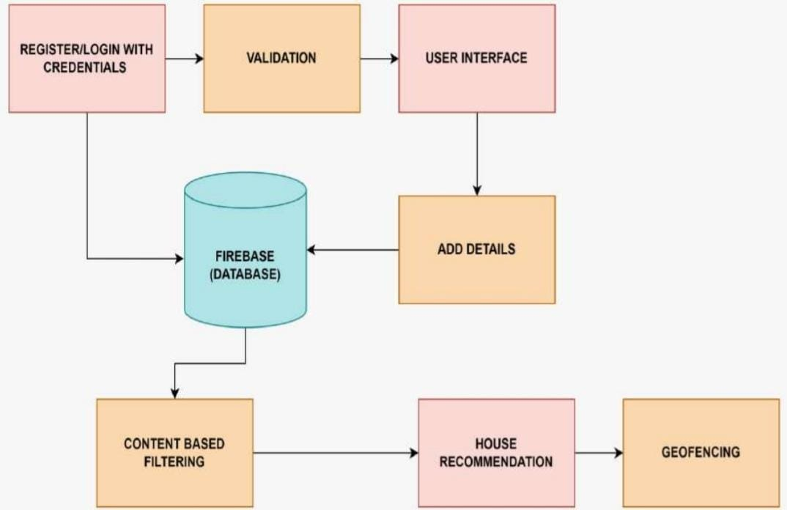
2.4 Activity diagram

Slide 18
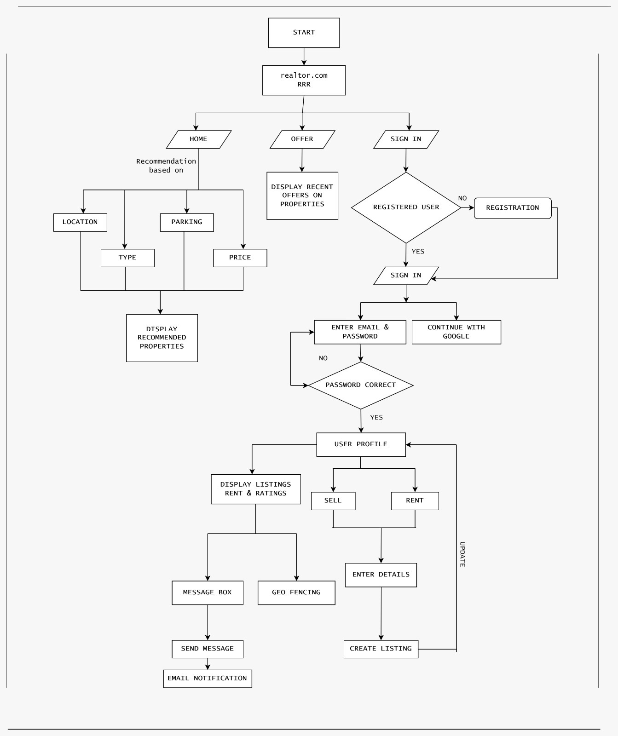
2.5 Class Diagram

Slide 19
3. Implementation

Slide 20
4. Testing

Slide 21
5. Result

Slide 22
6. Conclusion and Future Scope

Slide 23
References
[1] Castelblanco, A., Solano, J., Lopez, C., Rivera, E., Tengana, L., Ochoa, M. (2020). Machine Learning Techniques for Identity Document Verification in Uncontrolled Environments: A Case Study. In: Figueroa Mora, K., Anzurez Mar´ın, J., Cerda, J., CarrascoOchoa, J., Mart´ınez-Trinidad, J., Olvera-L´opez, J. (eds) Pattern Recognition. MCPR 2020. Lecture Notes in Computer Science(), vol 12088.
[2] Alrawhani E.M., Basirona H, Sa’ayaa Z.Real estate recommender system using case-based reasoning approach Journal of Telecommunication, Electronic and Computer Engineering (JTEC), 8 (2) (2016)
[3] Jinhao, X., Arefin, M.S., Zhiming, C., Morimoto, Y.. Real estate recommender: Location query for selecting spatial objects. In: 2012 Third International Conference on Networking and Computing. IEEE; 2012

Slide 24
Paper Publication
Paper entitled “ML Based Comprehensive Web Framework for facilitating Paying Guest” is under process to be published by “Samiksha Sakharam Pawar”, ”Ragini Santosh Pandey”, ”Shreyasha Suresh Vinerkar”.

Slide 25
Thank You

